Slide 1
Convolutional Neural Network
Prof. Somesh Nandi

Slide 2
Introduction
A Convolutional Neural Network (CNN) is a type of Deep Learning neural network architecture .commonly used in Computer Vision.
Why CNN?
Key Limitations of Traditional Neural Networks:
High Computational Cost
Loss of Spatial Information
Inefficient for Large Images

Slide 3
Why CNN?
Example: Handwritten Digit Recognition
Task: Classify a handwritten digit from a grayscale of 28×28-pixel image.
Using a Traditional Neural Network:
Input size: 28×28=784 pixels. Each pixel is treated as an independent feature.
Number of parameters (1 hidden layer, 1000 neurons): 784×1000=784,000.
This network ignores spatial patterns (e.g., edges or curves forming digits) and relies on brute-force learning, leading to poor efficiency and generalization.
Using a CNN:
Instead of feeding all pixels at once, a convolutional layer applies filters (e.g., 3×3 to detect edges, curves, and textures.
A pooling layer (e.g., max pooling) reduces dimensions while preserving key features.
The network learns hierarchical patterns: edges → shapes → digits.
Number of parameters for a filter: 3×3=9 . Even with multiple filters, parameter count is far smaller than an FCNN.

Slide 4
Historical Perspective and Biological Inspiration
The concept of Convolutional Neural Networks (CNNs) finds its roots in the study of the human visual system, particularly the brain's visual cortex.
Neurons in the primary visual cortex (V1) detect simple features such as edges, orientations, and gradients.
Higher layers integrate these simple features into more complex patterns, like shapes and objects.
Biological Parallel in CNNs: CNNs mimic this hierarchical structure:
Convolutional layers detect low-level features (edges, textures).
Deeper layers combine these features to recognize higher-level patterns (objects, faces).
Hubel and Wiesel's Findings (1962): David Hubel and Torsten Wiesel demonstrated that specific neurons in the cat’s visual cortex respond to particular edge orientations and locations

Slide 5
Historical Perspective and Biological Inspiration
Birth of Convolutional Neural Networks
Neocognitron (1980): Kunihiko Fukushima proposed the Neocognitron, an early model inspired by Hubel and Wiesel’s findings. It introduced hierarchical layers for pattern recognition and shared weights, precursors to modern CNNs.
It was one of the first models to incorporate local receptive fields and hierarchical feature extraction.
LeNet-5 (1989): Yann LeCun and colleagues developed the first practical CNN, LeNet-5, designed for digit recognition in postal systems. Key contributions included:
Convolutional layers for feature extraction.
Pooling layers to reduce spatial dimensions and maintain invariance.
End-to-end training using gradient descent.

Slide 6
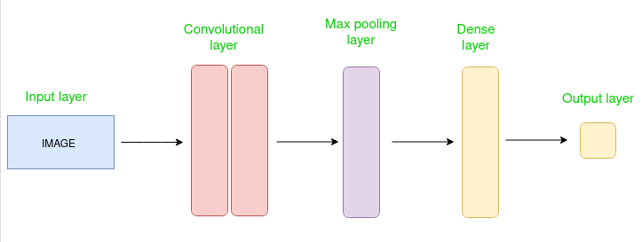
Basic Structure of a Convolutional Network
The Convolutional layer applies filters to the input image to extract features, the Pooling layer down samples the image to reduce computation, and the fully connected layer makes the final prediction.
The network learns the optimal filters through backpropagation and gradient descent

Slide 7
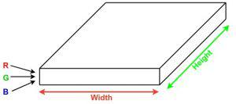
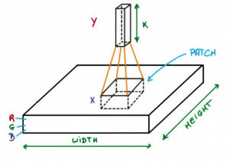
Convolutional Layer (Filter)
A filter (also called a kernel) in a Convolutional Neural Network (CNN) is a small matrix of learnable weights used to detect specific features in input data, such as edges, textures, or patterns.
Filters are at the heart of the convolutional operation, enabling CNNs to learn and extract hierarchical features from input images.
Size: Filters are typically much smaller than the input data. Common sizes include 3×3 5×5 , 7×7
Example: For a 28×28 , 3×3 filter slides across the image to analyze local regions.
Now imagine taking a small patch of this image and running a small neural network, called a filter or kernel on it, with say, K outputs and representing them vertically.
Now slide that neural network across the whole image, as a result, we will get another image with different widths, heights, and depths.
Instead of just R, G, and B channels now we have more channels but lesser width and height. This operation is called Convolution

Slide 8
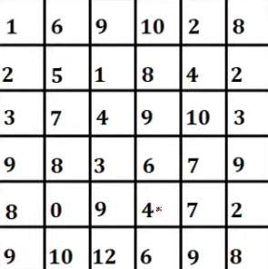
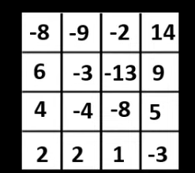
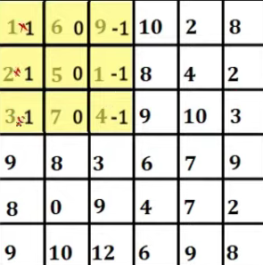
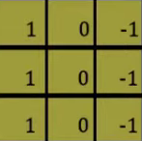


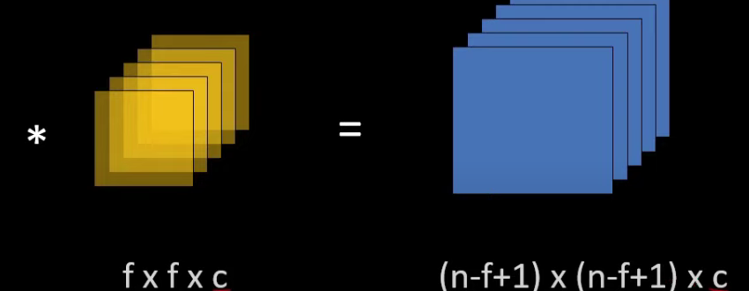

Slide 9
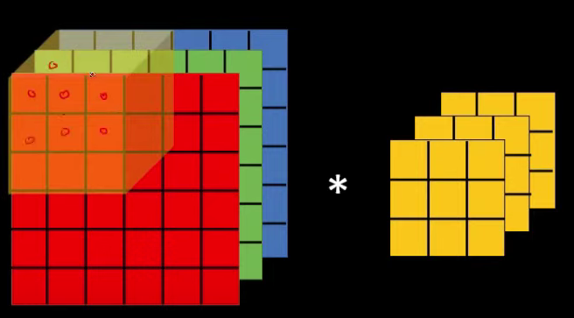
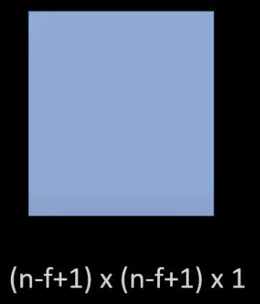



Slide 10
Stride
Stride in a Convolutional Neural Network (CNN) refers to the step size with which the convolutional filter moves across the input feature map during the convolution operation.
Key Characteristics of Stride
Default Stride:
A stride of S=1 means the filter moves one pixel at a time.
This results in maximum overlap between adjacent filter applications and produces the largest output size.
Larger Stride:
A stride of S=2means the filter moves two pixels at a time.
This skips some input data, resulting in a smaller output feature map (down sampling).
S = [n-f/s]+1

Slide 11
Padding
Padding in Convolutional Neural Networks (CNNs) refers to adding extra layers of pixels around the edges of an input image or feature map. This technique is used to control the spatial dimensions of the output after a convolution operation.
Why Use Padding?
Preserve Spatial Dimensions:
Without padding, applying filters reduces the dimensions of the input feature map, especially near the edges.
Padding ensures that the output has the same dimensions as the input (in "same" padding).
Prevent Information Loss:
Filters inherently struggle to process the edges of an image because there are fewer surrounding pixels.
Padding provides artificial pixels (usually zeroes) so that edge features are captured effectively.
Allow Deeper Networks:
Maintaining dimensions across layers (using padding) helps design deeper networks without quickly shrinking the feature maps.

Slide 12
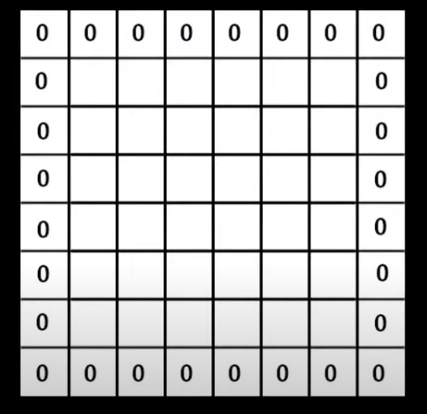
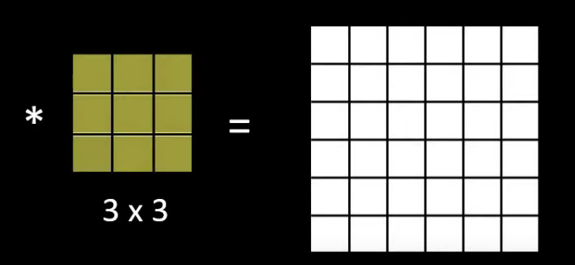
Types of Padding
Zero Padding:
Adds zero-value pixels around the edges.
Most common type of padding used in CNNs.
Valid Padding:
No padding is added. Convolutions are applied only where the filter completely overlaps the input.
Results in smaller output dimensions.
Same Padding:
Adds enough padding so the output dimensions are the same as the input dimensions.
Ensures consistent size across layers.
Padding = [n-f+2p/s]+1

Slide 13
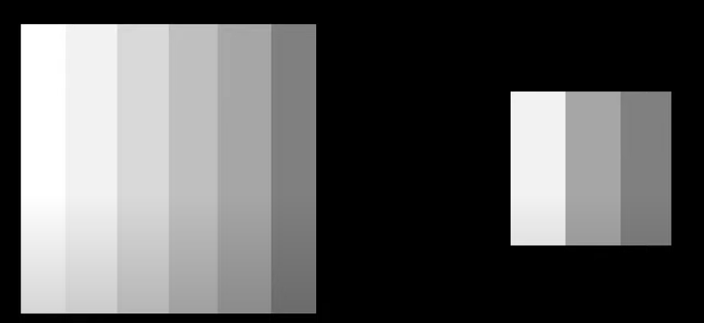
Pooling
Pooling in Convolutional Neural Networks (CNNs) is a technique used to reduce the spatial dimensions of the input feature maps while retaining essential features.
It helps in reducing the computational complexity and controlling overfitting by summarizing the features in a region of the image.
Pooling is typically applied after the convolutional layers to reduce the size of the feature maps and make the network more computationally efficient.
There are two type of pooling : Max Pooling and Average Pooling

Slide 14
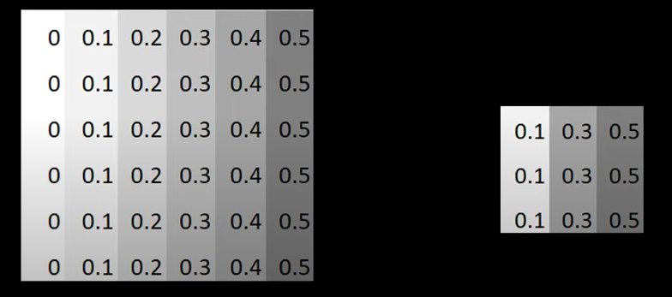
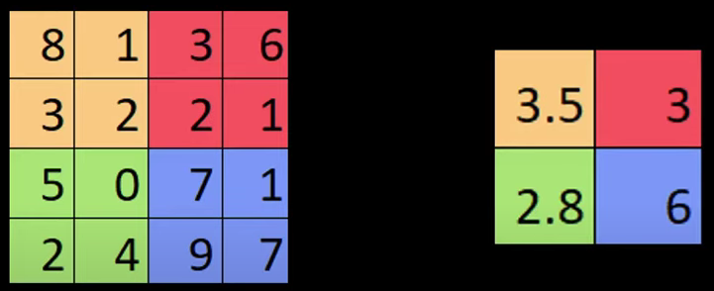
Max Pooling
Average Pooling

Slide 15
Typical Settings
Filter Size (Kernel Size):
Commonly 3x3 or 5x5 for convolution operations.
Determines the receptive field to extract features like edges and textures.
Stride:
Default is 1 for overlapping coverage.
Larger strides (e.g., 2) reduce dimensionality but risk losing fine-grained details.
Padding:
Same Padding: Maintains input dimensions by padding with zeros.
Valid Padding: No padding, reduces spatial dimensions.
Pooling Layer:
Typically uses max pooling or average pooling with a size of 2x2 and a stride of 2.
Reduces spatial dimensions and retains dominant features.

Slide 16
Typical Settings
Activation Functions:
ReLU (Rectified Linear Unit) is widely used for introducing non-linearity.
Alternatives include Leaky ReLU, Tanh, or Sigmoid depending on the task.
Number of Filters (Channels):
Starts with fewer filters (e.g., 32 or 64) in early layers.
Increases in deeper layers (e.g., 128, 256, 512) to capture complex patterns.
Fully Connected Layers:
Typically 1–2 layers at the end, used for classification or regression tasks.

Slide 17
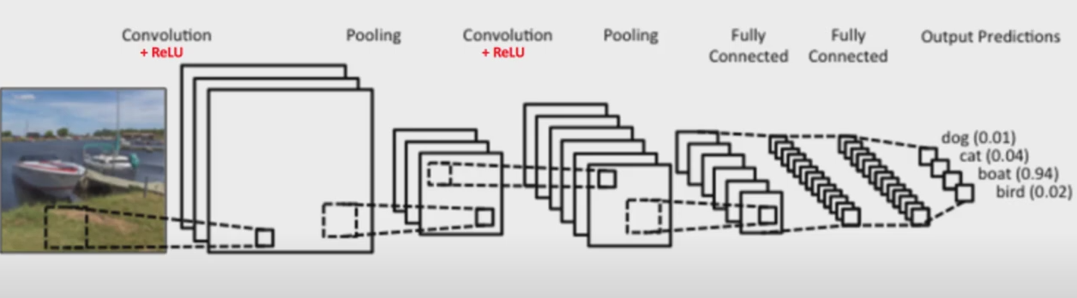
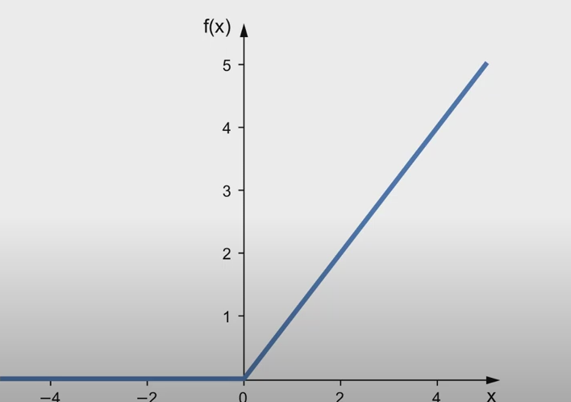
The ReLU Layer
The ReLU (Rectified Linear Unit) layer is a key component in convolutional neural networks (CNNs) that helps introduce non-linearity to the model.
The ReLU activation function is defined as f(x)=max⁡(0,x) This means that if the input is positive, it passes through unchanged, but if the input is negative, it is set to zero. This introduces non-linearity into the network, allowing it to learn complex patterns.

Slide 18
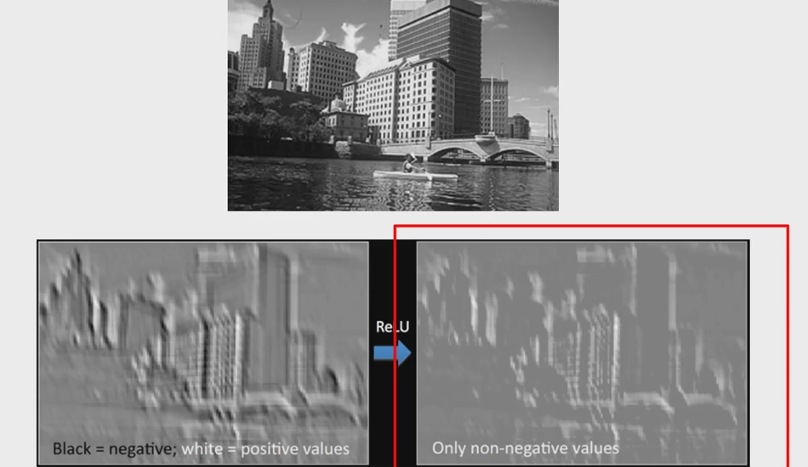
The ReLU Layer

Slide 19
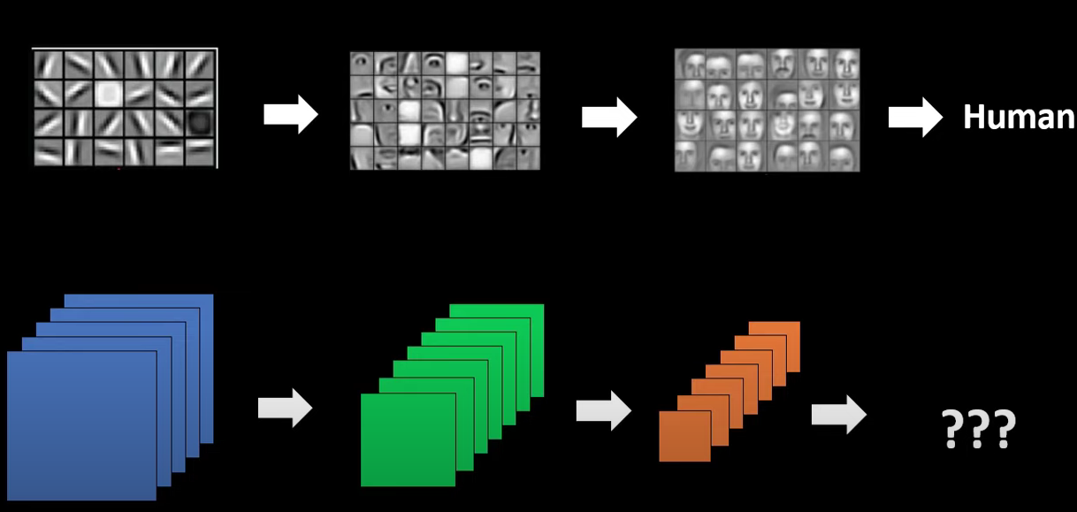
Fully Connected Layer
After extracting all the features, what next?
How do I classify or label?
[Input Image] → [Convolutional Layers] → [Pooling Layers] → [Fully Connected Layers] → [Output]

Slide 20
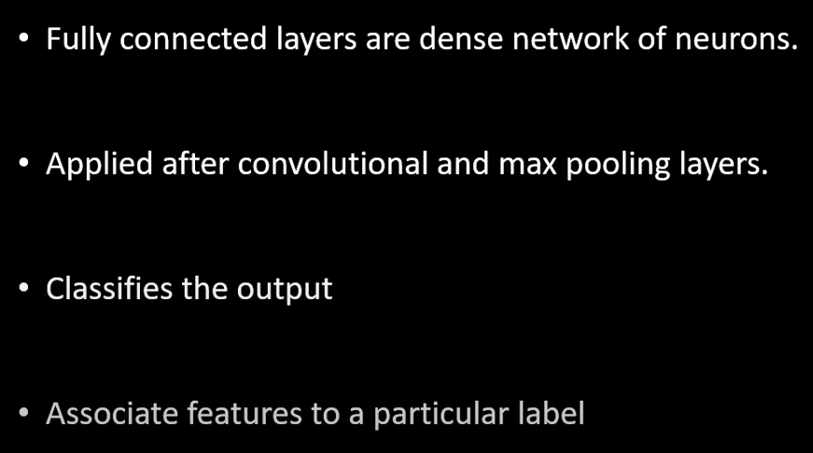
Fully Connected Layer

Slide 21
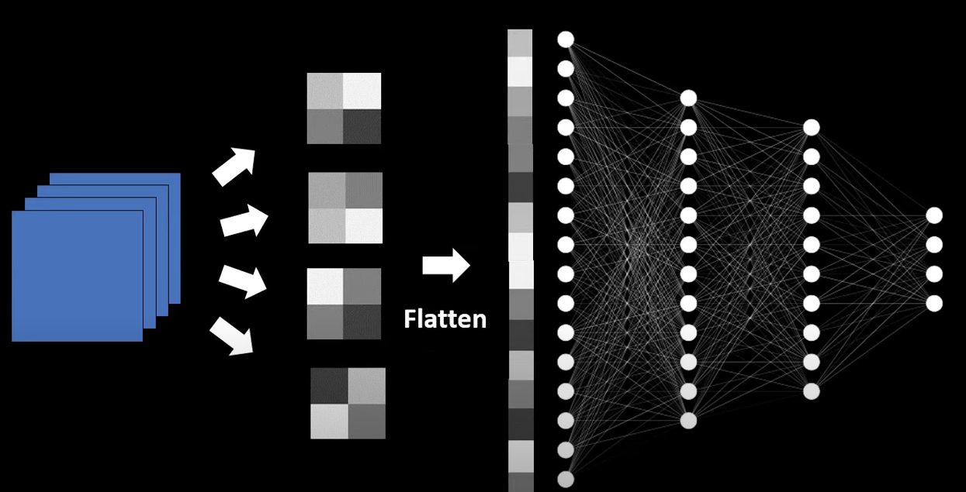
Fully Connected Layer

Slide 22
Interleaving Between Layers
Refers to inserting different types of layers or operations in between the primary layers (e.g., convolutional, pooling, and fully connected layers) to improve the overall performance and efficiency of the network.
Example
[Input Image] → [Convolution Layer] → [Batch Normalization] → [Activation (ReLU)] → [Pooling Layer] → [Convolution Layer] → [Dropout] → [Fully Connected Layer] → [Output]
Batch Normalization: This layer can be inserted between the convolutional and activation layers to normalize the inputs. This speeds up training and improves the stability of the model.
Dropout Layers: Used to prevent overfitting, dropout layers can be interleaved between other layers to randomly drop neurons during training, which helps the network generalize better.

Slide 23
Local Response Normalization (LRN) in CNN: Key Points
Purpose: LRN is used to enhance the generalization ability of CNNs by normalizing the activity of neurons within a local neighborhood, making the network more robust to variations and reducing the risk of overfitting.
Function: It works by normalizing the output of a neuron relative to the responses of its local neighborhood. This is done to amplify prominent features while suppressing less significant ones.
Mathematical Operation: LRN is typically defined using a formula that normalizes the output xi​ of a neuron with respect to the sum of squares of its neighboring neurons within a specific radius.
Local Receptive Field: Normalization is applied within a small region of the input feature map, known as the local receptive field.

Slide 24
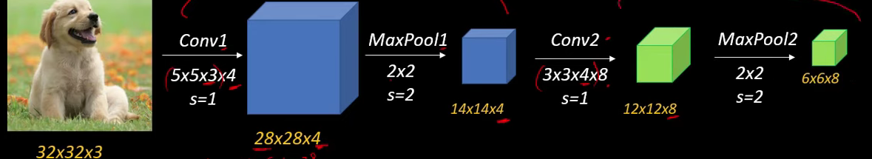
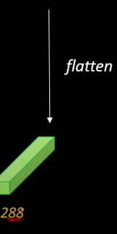
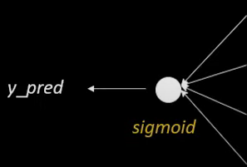
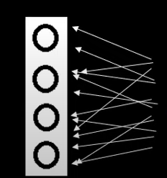
Summary

Slide 25
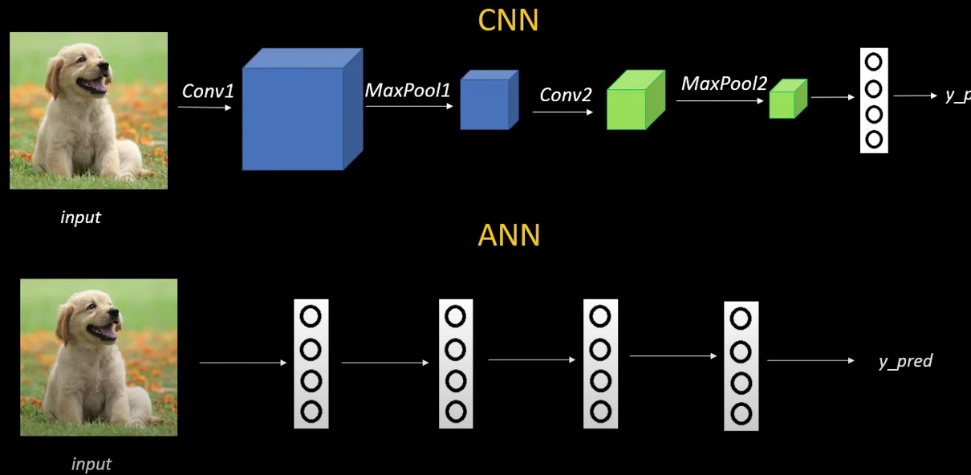
Comparison between CNN and ANN

Slide 26
Backpropagation in convolutional networks
Similar to Feed-Forward Networks:
Backpropagation in convolutional layers works like in standard feed-forward networks, except it deals with convolution operations instead of simple matrix multiplications.
Role of Error Gradients:
The error gradients for the next layer (i+1) are already calculated during backpropagation.
These gradients represent how much the loss (or error) changes with respect to activations in layer i+1.
Contributions from Previous Layer:
Each cell in layer i+1 is created by applying a filter over a specific region (a "volume") of layer i.
Thus, many elements in layer i contribute to creating a single cell in layer i+1.

Slide 27
Backpropagation in convolutional networks
Backward Propagation of Errors:
During backpropagation, the error from a cell in layer i+1 is distributed back to the cells in layer i that contributed to it.
The error is scaled by the corresponding filter weights and added up at each contributing cell.
For every cell in layer i:
Multiply the error gradient of each cell it contributes to in layer i+1 by the associated filter weights.
Sum these contributions to update the gradient for the current cell in layer i.

Slide 28
Backpropagation in convolutional networks
Backward Propagation of Errors:
During backpropagation, the error from a cell in layer i+1 is distributed back to the cells in layer i that contributed to it.
The error is scaled by the corresponding filter weights and added up at each contributing cell.
For every cell in layer i:
Multiply the error gradient of each cell it contributes to in layer i+1 by the associated filter weights.
Sum these contributions to update the gradient for the current cell in layer i.

Slide 29
Backpropagation in convolutional networks
Backward Propagation of Errors:
During backpropagation, the error from a cell in layer i+1 is distributed back to the cells in layer i that contributed to it.
The error is scaled by the corresponding filter weights and added up at each contributing cell.
For every cell in layer i:
Multiply the error gradient of each cell it contributes to in layer i+1 by the associated filter weights.
Sum these contributions to update the gradient for the current cell in layer i.

Slide 30
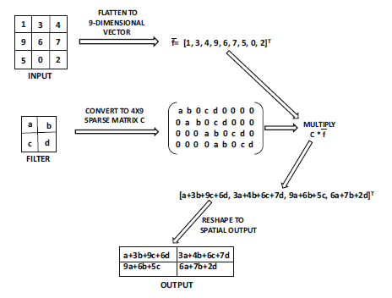
Convolution/Back propagation as Matrix Multiplications
Flatten Input:
A 2D input matrix (e.g., 3×3) is reshaped into a 1D column vector AI-dimensional, where AI=n*n..
This is done by concatenating rows of the input matrix from top to bottom.
Sparse Convolution Matrix C:
A sparse matrix C of size AO×AI is created, where AO=(n−f+1)×(n−f+1)
Each row of C corresponds to a convolution region in the input matrix.
Non-zero values in C come from the filter weights, positioned according to their contribution to that convolution.
Matrix Multiplication:
Multiply C (convolution matrix) with f (flattened input vector).
The result Cf is a vector of size AO, which represents the output of the convolution operation.
Reshape Output:
Reshape Cf (e.g., a 4-element vector for a 2×2 output) back into its original spatial structure, using the spatial locations in C.

Slide 31
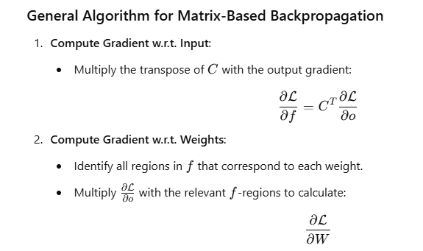
Convolution/Back propagation as Matrix Multiplications

Slide 32
Data Augmentation
What is Data Augmentation?
It's a technique to reduce overfitting by generating new training data from existing data using transformations.
Why is it Useful?
Increases the generalization ability of the model.
Helps the model recognize objects in different orientations, lighting, and conditions.
Common Transformations in Image Processing:
Translation: Shift the image slightly in any direction.
Rotation: Rotate the image by a certain angle.
Reflection (Mirroring): Flip the image horizontally or vertically.
Patch Extraction: Use smaller patches or crops from the image.
Color Intensity Adjustment: Vary the brightness or color levels.

Slide 33
Data Augmentation
Efficient Implementation:
Most transformations are computationally light and can be performed during training without pre-saving altered images.
For example, mirroring an image of a banana during training allows the model to learn from both original and mirrored versions.
Advanced Transformation Using PCA:
Principal Component Analysis (PCA) is used to change image color intensities more systematically.
A 3×3 covariance matrix is computed for pixel values.
Gaussian noise (zero mean, variance of 0.01) is added to principal components, simulating different lighting conditions.

